Slide 1
Queue:
A Queue is an abstract data structure, defined as a linear data structure that is open at both ends and the operations are performed in First In First Out (FIFO) order.
We define a queue to be a list in which all additions to the list are made at one end, and all deletions from the list are made at the other end.
The element which is first pushed into the order, the operation is first performed on that.
A queue is open at both its ends.
One end is always used to insert data (enqueue) and the other is used to remove data (dequeue).
Queue follows First-In-First-Out methodology, i.e., the data item stored first will be accessed first.

Slide 2
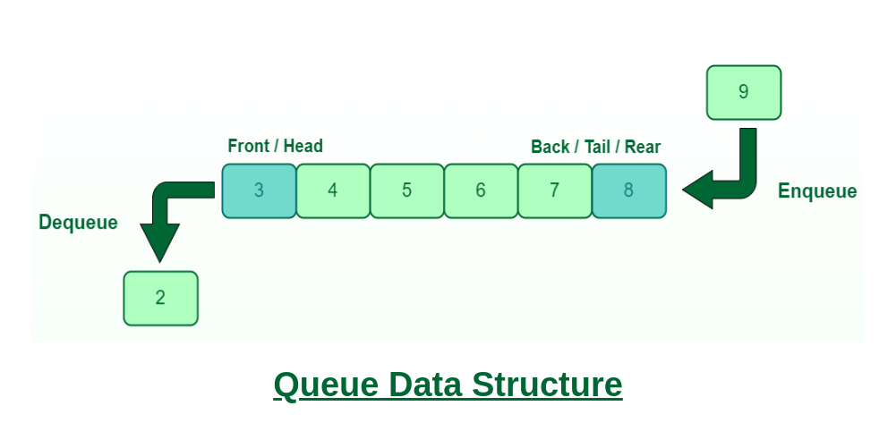

Slide 3
FIFO Principle of Queue:
A Queue is like a line waiting to purchase tickets, where the first person in line is the first person served. (i.e. First come first serve).
Position of the entry in a queue ready to be served, that is, the first entry that will be removed from the queue, is called the front of the queue(sometimes, head of the queue), similarly, the position of the last entry in the queue, that is, the one most recently added, is called the rear (or the tail) of the queue.

Slide 4
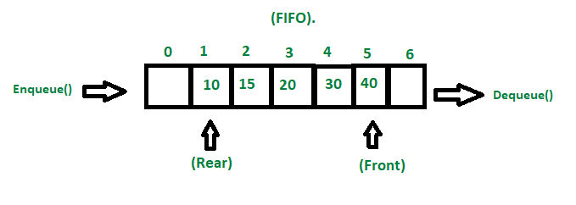

Slide 5
Characteristics of Queue:
Queue can handle multiple data.
We can access both ends.
They are fast and flexible.
Types of Queue:
There are four different types of queue as follows;
Simple Queue or Linear Queue
Circular Queue
Priority Queue
Double Ended Queue (or Deque)

Slide 6
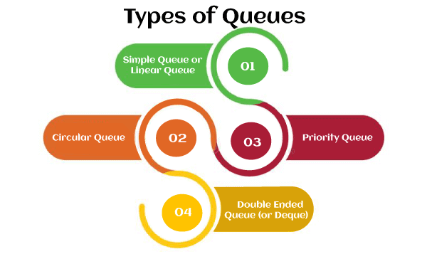

Slide 7
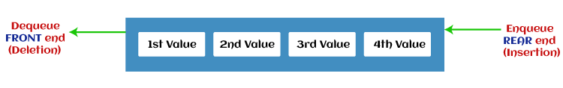
Simple Queue or Linear Queue:
In Linear Queue, an insertion takes place from one end while the deletion occurs from another end.
The end at which the insertion takes place is known as the rear end, and the end at which the deletion takes place is known as front end.
It strictly follows the FIFO rule.

Slide 8
The major drawback of using a linear Queue is that insertion is done only from the rear end.
If the first three elements are deleted from the Queue, we cannot insert more elements even though the space is available in a Linear Queue.
In this case, the linear Queue shows the overflow condition as the rear is pointing to the last element of the Queue.

Slide 9
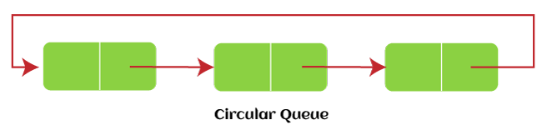
Circular Queue:
In Circular Queue, all the nodes are represented as circular.
It is similar to the linear Queue except that the last element of the queue is connected to the first element.
It is also known as Ring Buffer, as all the ends are connected to another end.
The representation of circular queue is shown in the below image –

Slide 10
The drawback that occurs in a linear queue is overcome by using the circular queue.
If the empty space is available in a circular queue, the new element can be added in an empty space by simply incrementing the value of rear.
The main advantage of using the circular queue is better memory utilization.

Slide 11
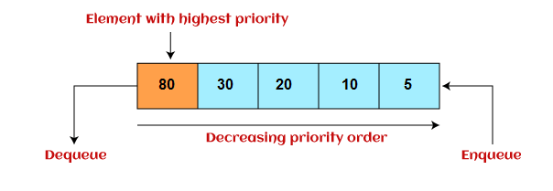
Priority Queue:
It is a special type of queue in which the elements are arranged based on the priority.
It is a special type of queue data structure in which every element has a priority associated with it.
Suppose some elements occur with the same priority, they will be arranged according to the FIFO principle.
The representation of priority queue is shown in the below image;

Slide 12
Insertion in priority queue takes place based on the arrival, while deletion in the priority queue occurs based on the priority.
Priority queue is mainly used to implement the CPU scheduling algorithms.
There are two types of priority queue that are discussed as follows;
Ascending priority queue:
In ascending priority queue, elements can be inserted in arbitrary order, but only smallest can be deleted first.
Suppose an array with elements 7, 5, and 3 in the same order, so, insertion can be done with the same sequence, but the order of deleting the elements is 3, 5, 7.

Slide 13
Descending priority queue:
In descending priority queue, elements can be inserted in arbitrary order, but only the largest element can be deleted first.
Suppose an array with elements 7, 3, and 5 in the same order, so, insertion can be done with the same sequence, but the order of deleting the elements is 7, 5, 3.

Slide 14
Deque (or, Double Ended Queue):
In Deque or Double Ended Queue, insertion and deletion can be done from both ends of the queue either from the front or rear.
It means that we can insert and delete elements from both front and rear ends of the queue.
Deque can be used as a palindrome checker means that if we read the string from both ends, then the string would be the same.
Deque can be used both as stack and queue as it allows the insertion and deletion operations on both ends.
Deque can be considered as stack because stack follows the LIFO (Last In First Out) principle in which insertion and deletion both can be performed only from one end.
And in deque, it is possible to perform both insertion and deletion from one end, and Deque does not follow the FIFO principle.

Slide 15
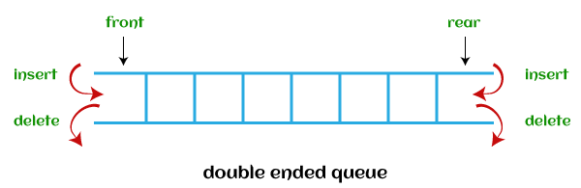
The representation of the deque is shown in the below image;

Slide 16
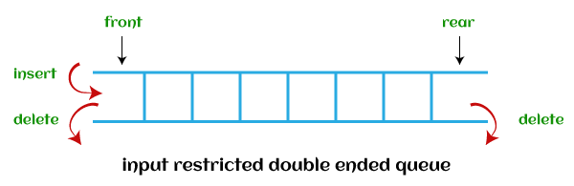
There are two types of deque as follows;
Input restricted deque:
As the name implies, in input restricted queue, insertion operation can be performed at only one end, while deletion can be performed from both ends.

Slide 17
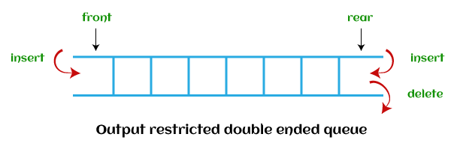
Output restricted deque:
As the name implies, in output restricted queue, deletion operation can be performed at only one end, while insertion can be performed from both ends.

Slide 18
Operations performed on queue:
The fundamental (Basic) operations that can be performed on queue are as follows;
Enqueue:
The Enqueue operation is used to insert the element at the rear end of the queue.
It returns void.
Dequeue:
It performs the deletion from the front-end of the queue.
It also returns the element which has been removed from the front-end.
It returns an integer value.

Slide 19
Enqueue Operation:
Queues maintain two data pointers, front and rear.
Therefore, its operations are comparatively difficult to implement than that of stacks.
The following steps should be taken to enqueue (insert) data into a queue;
Step 1 − Check if the queue is full.
Step 2 − If the queue is full, produce overflow error and exit.
Step 3 − If the queue is not full, increment rear pointer to point the next empty space.
Step 4 − Add data element to the queue location, where the rear is pointing.
Step 5 − return success.

Slide 20
Dequeue Operation:
Accessing data from the queue is a process of two tasks, access the data where front is pointing and remove the data after access.
The following steps are taken to perform dequeue operation;
Step 1 − Check if the queue is empty.
Step 2 − If the queue is empty, produce underflow error and exit.
Step 3 − If the queue is not empty, access the data where front is pointing.
Step 4 − Increment front pointer to point to the next available data element.
Step 5 − Return success.

Slide 21
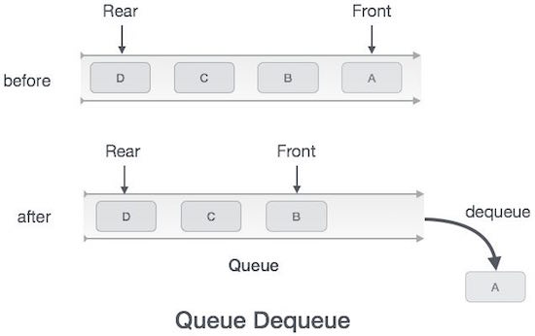

Slide 22
Ways to implement the queue:
There are two ways of implementing the Queue:
Implementation using array:
The sequential allocation in a Queue can be implemented using an array.
Implementation using Linked list:
The linked list allocation in a Queue can be implemented using a linked list.

Slide 23
Array representation of Queue:
We can easily represent queue by using linear arrays.
There are two variables i.e. front and rear, that are implemented in the case of every queue.
Front and rear variables point to the position from where insertions and deletions are performed in a queue.
Initially, the value of front and queue is -1 which represents an empty queue.

Slide 24
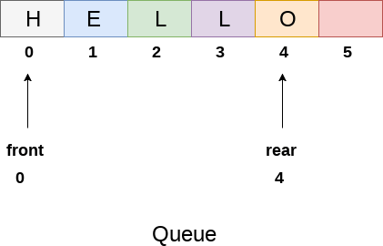
Array representation of a queue containing 5 elements along with the respective values of front and rear, is shown in the following figure.

Slide 25
The above figure shows the queue of characters forming the English word "HELLO".
Since, No deletion is performed in the queue till now, therefore the value of front remains 0.
However, the value of rear increases by one every time an insertion is performed in the queue.
After inserting an element into the queue shown in the above figure, the queue will look something like following.
The value of rear will become 5 while the value of front remains same.

Slide 26
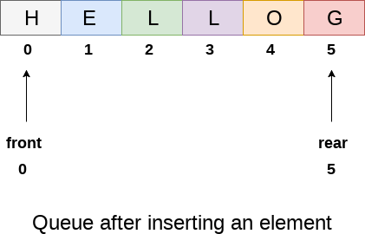

Slide 27
Drawback of array implementation:
Although, the technique of creating a queue is easy, but there are some drawbacks of using this technique to implement a queue.
Memory wastage :
The space of the array, which is used to store queue elements, can never be reused to store the elements of that queue because the elements can only be inserted at front end and the value of front might be so high so that, all the space before that, can never be filled.

Slide 28
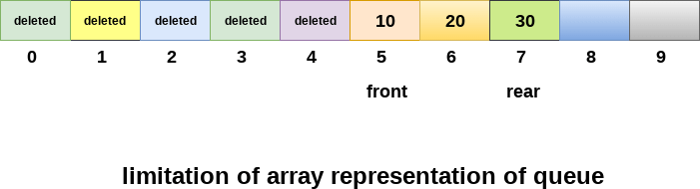
The above figure shows how the memory space is wasted in the array representation of queue.
In the above figure, a queue of size 10 having 3 elements, is shown.
The value of the front variable is 5, therefore, we can not reinsert the values in the place of already deleted element before the position of front.
That much space of the array is wasted and can not be used in the future (for this queue).

Slide 29
Deciding the array size:
On of the most common problem with array implementation is the size of the array which requires to be declared in advance.
Due to the fact that, the queue can be extended at runtime depending upon the problem, the extension in the array size is a time taking process and almost impossible to be performed at runtime since a lot of reallocations take place.
Due to this reason, we can declare the array large enough so that we can store queue elements as enough as possible but the main problem with this declaration is that, most of the array slots (nearly half) can never be reused.
It will again lead to memory wastage.

Slide 30
Linked List implementation of Queue:
Due to the drawbacks discussed in the array implementation, it can not be used for the large scale applications where the queues are implemented.
One of the alternative of array implementation is linked list implementation of queue.
The storage requirement of linked representation of a queue with n elements is o(n) while the time requirement for operations is o(1).
In a linked queue, each node of the queue consists of two parts i.e. data part and the link part. Each element of the queue points to its immediate next element in the memory.

Slide 31
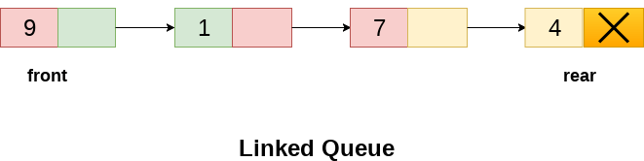
In the linked queue, there are two pointers maintained in the memory i.e. front pointer and rear pointer.
The front pointer contains the address of the starting element of the queue while the rear pointer contains the address of the last element of the queue.
Insertion and deletions are performed at rear and front end respectively.
If front and rear both are NULL, it indicates that the queue is empty.
The linked representation of queue is shown in the following figure.

Slide 32
Operation on Linked Queue
There are two basic operations which can be implemented on the linked queues.
The operations are Insertion and Deletion.
Insert operation:
The insert operation append the queue by adding an element to the end of the queue.
The new element will be the last element of the queue.
Firstly, allocate the memory for the new node ptr by using the following statement;
Ptr = (struct node *) malloc (sizeof(struct node));

Slide 33
There can be the two scenario of inserting this new node ptr into the linked queue.
In the first scenario, we insert element into an empty queue.
In this case, the condition front = NULL becomes true.
Now, the new element will be added as the only element of the queue and the next pointer of front and rear pointer both, will point to NULL.
ptr -> data = item;
if(front == NULL)
{
front = ptr;
rear = ptr;
front -> next = NULL;
rear -> next = NULL;
}

Slide 34
In the second case, the queue contains more than one element.
The condition front = NULL becomes false.
In this scenario, we need to update the end pointer rear so that the next pointer of rear will point to the new node ptr.
Since, this is a linked queue, hence we also need to make the rear pointer point to the newly added node ptr.
We also need to make the next pointer of rear point to NULL.
rear -> next = ptr;
rear = ptr;
rear->next = NULL;
In this way, the element is inserted into the queue.

Slide 35
Algorithm:
Step 1: Allocate the space for the new node PTR
Step 2: SET PTR -> DATA = VAL
Step 3: IF FRONT = NULL SET FRONT = REAR = PTR SET FRONT -> NEXT = REAR -> NEXT = NULL ELSE SET REAR -> NEXT = PTR SET REAR = PTR SET REAR -> NEXT = NULL [END OF IF]
Step 4: END

Slide 36
Deletion:
Deletion operation removes the element that is first inserted among all the queue elements.
Firstly, we need to check either the list is empty or not.
The condition front == NULL becomes true if the list is empty, in this case , we simply write underflow on the console and make exit.
Otherwise, we will delete the element that is pointed by the pointer front.
For this purpose, copy the node pointed by the front pointer into the pointer ptr.
Now, shift the front pointer, point to its next node and free the node pointed by the node ptr.

Slide 37
This is done by using the following statements.
ptr = front;
front = front -> next;
free(ptr);
Algorithm:
Step 1: IF FRONT = NULL Write " Underflow " Go to Step 5 [END OF IF]
Step 2: SET PTR = FRONT
Step 3: SET FRONT = FRONT -> NEXT
Step 4: FREE PTR
Step 5: END

Slide 38
Store an Element in a Queue:
Enqueue an element to a queue.
To store an element in a queue, you need to perform the following steps:
Check if the queue is full. If the queue is full, you cannot store any more elements in it.
If the queue is not full, then insert the element at the rear end of the queue.
This operation is called "enqueue" in the queue data structure.
After inserting the element, update the rear pointer of the queue to point to the newly added element.

Slide 39
Here's a sample code in Python to enqueue an element into a queue:
def enqueue(queue, element):
if len(queue) == MAX_SIZE:
print("Queue is full.")
else:
queue.append(element)
print("Element enqueued to the queue:", element)
In this code, queue is the list representing the queue and element is the element to be enqueued.
MAX_SIZE is the maximum size of the queue.

Slide 40
To enqueue an element, you can simply call the enqueue function passing the queue and the element to be enqueued:
queue = []
enqueue(queue, 10) # enqueues 10 to the queue
enqueue(queue, 20) # enqueues 20 to the queue
After executing the above code, the queue would look like: [10, 20] where 10 is at the front of the queue and 20 is at the rear.

